Slide 1


Welcome
CHATTERBOT
Improve your customer experiences

Slide 2
Problem Statement
Customer experience is very important factor for any support services industry
Outsourcing support centre very costly and not make much business impact
Handling support services is a very exhaustive and resources demanding

Slide 3




Solution
A chatbot platform where businesses can use as and when needed
Software As A Services
(SaaS) Subscription Model
Only Pay As You Use
Minimum Capital Investment
As you don’t need to develop from scratch
Less waiting time and can launch the service immediately
Start growing your business by embarking and enhancing customer experience

Slide 4
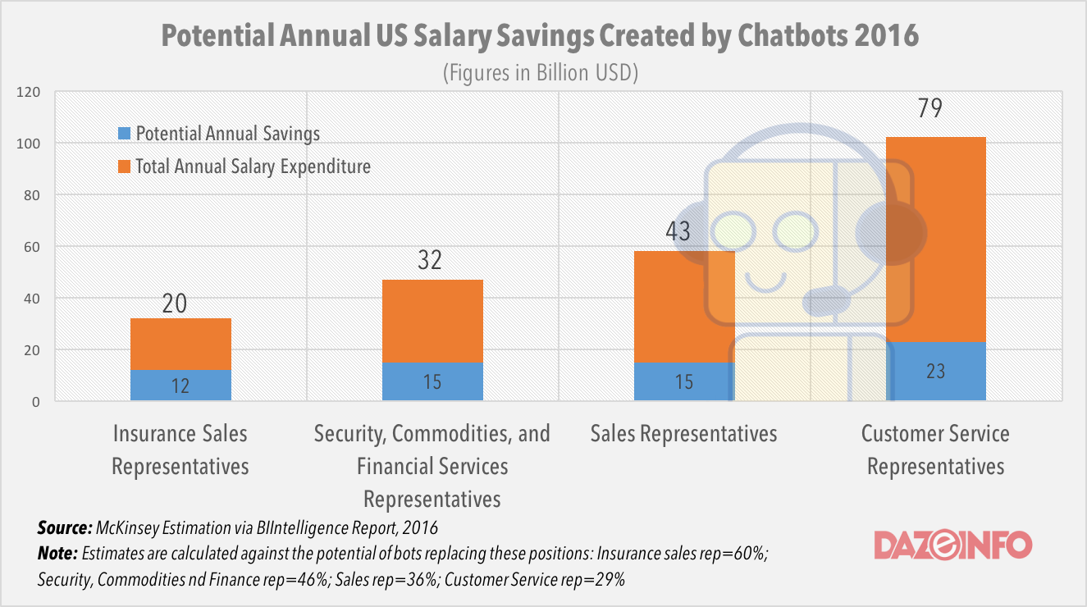
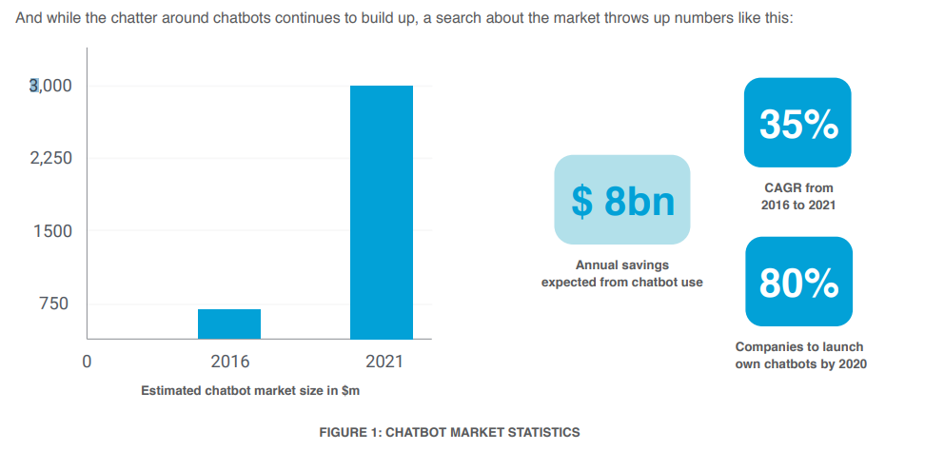
Market Validation

Slide 5
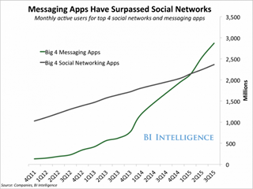
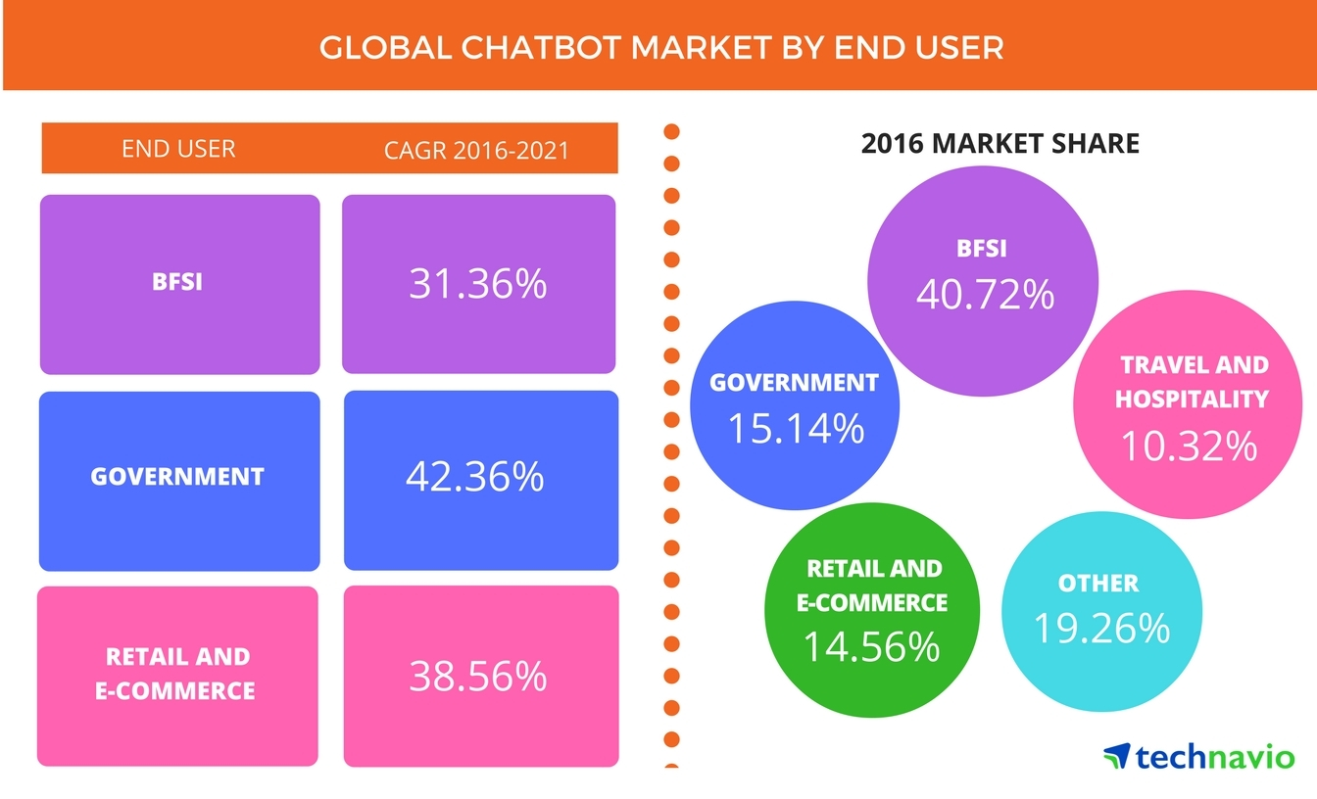
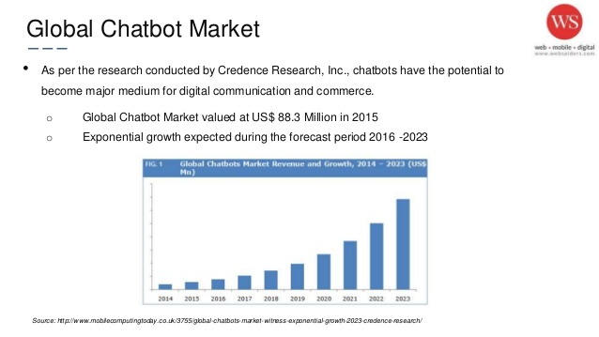
Market Size

Slide 6
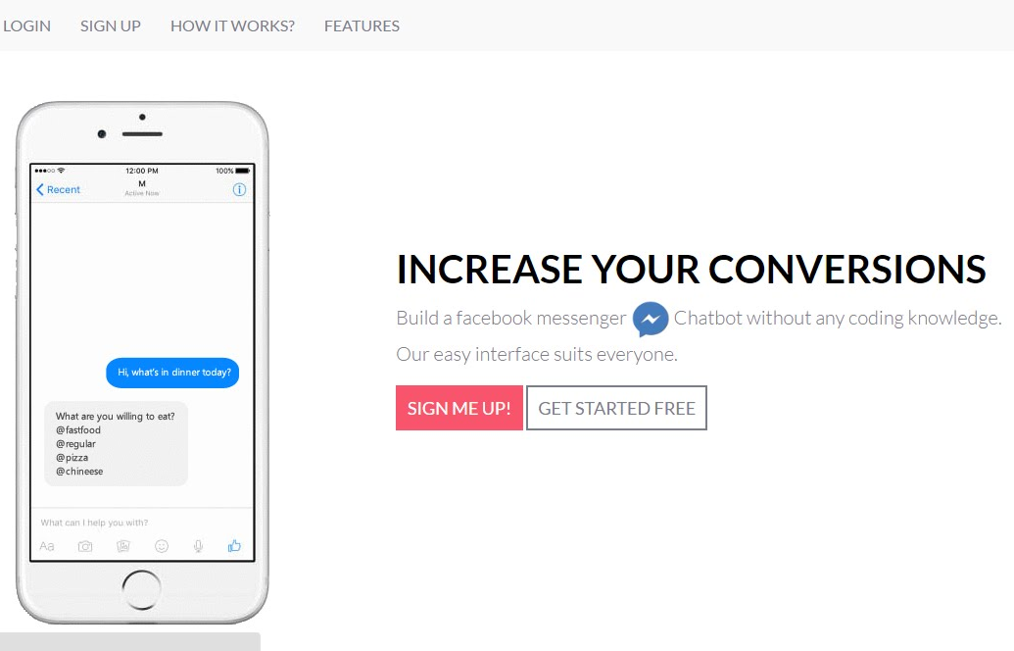
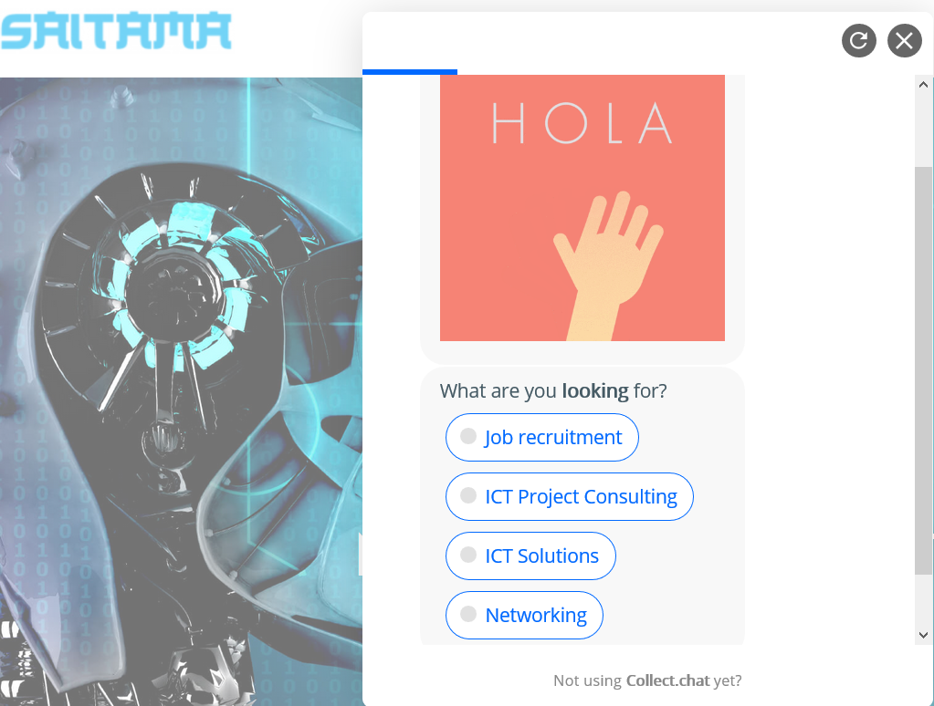
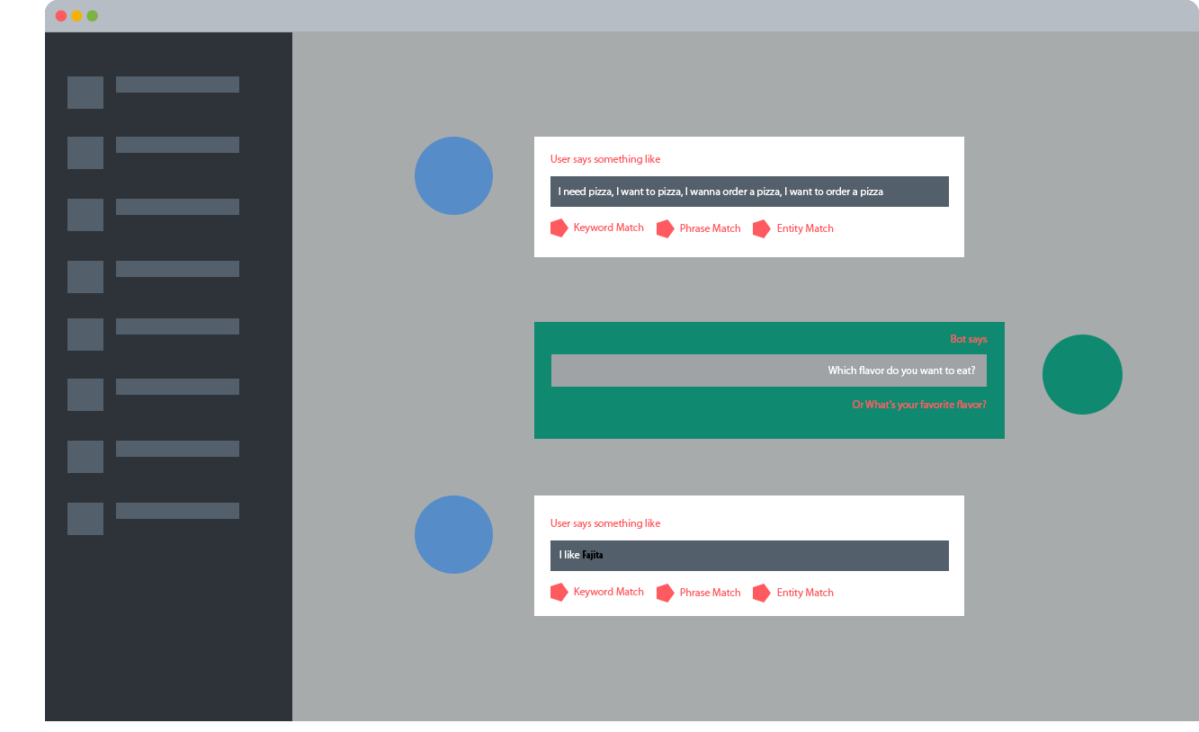
Product
Subscribe
Configure
Launch

Slide 7
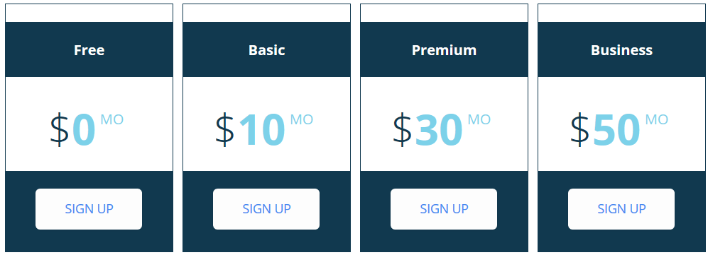
Business Model
The service is by package subscriptions
Capture 5% of market share
USD1.25B chatbot growth market share by 2025
USD62.5M
Estimate Revenue capture from 2018-2025

Slide 8



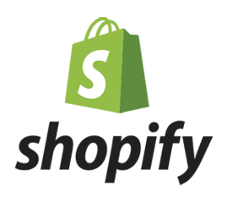







Market Adoption
Leverage and Deploy On top of Existing Messaging Channel
Partner with Technology Enabler

Slide 9



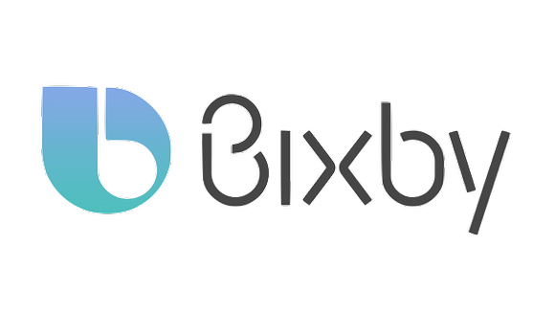

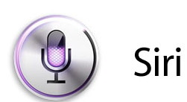

Competition
more convenient
more expensive
less expensive
less convenient

Slide 10
Competitive Advantages
easy deployment
easy to customize
easy to train bot
less hardcoding
can be rapidly train
API integration

